Slide 1



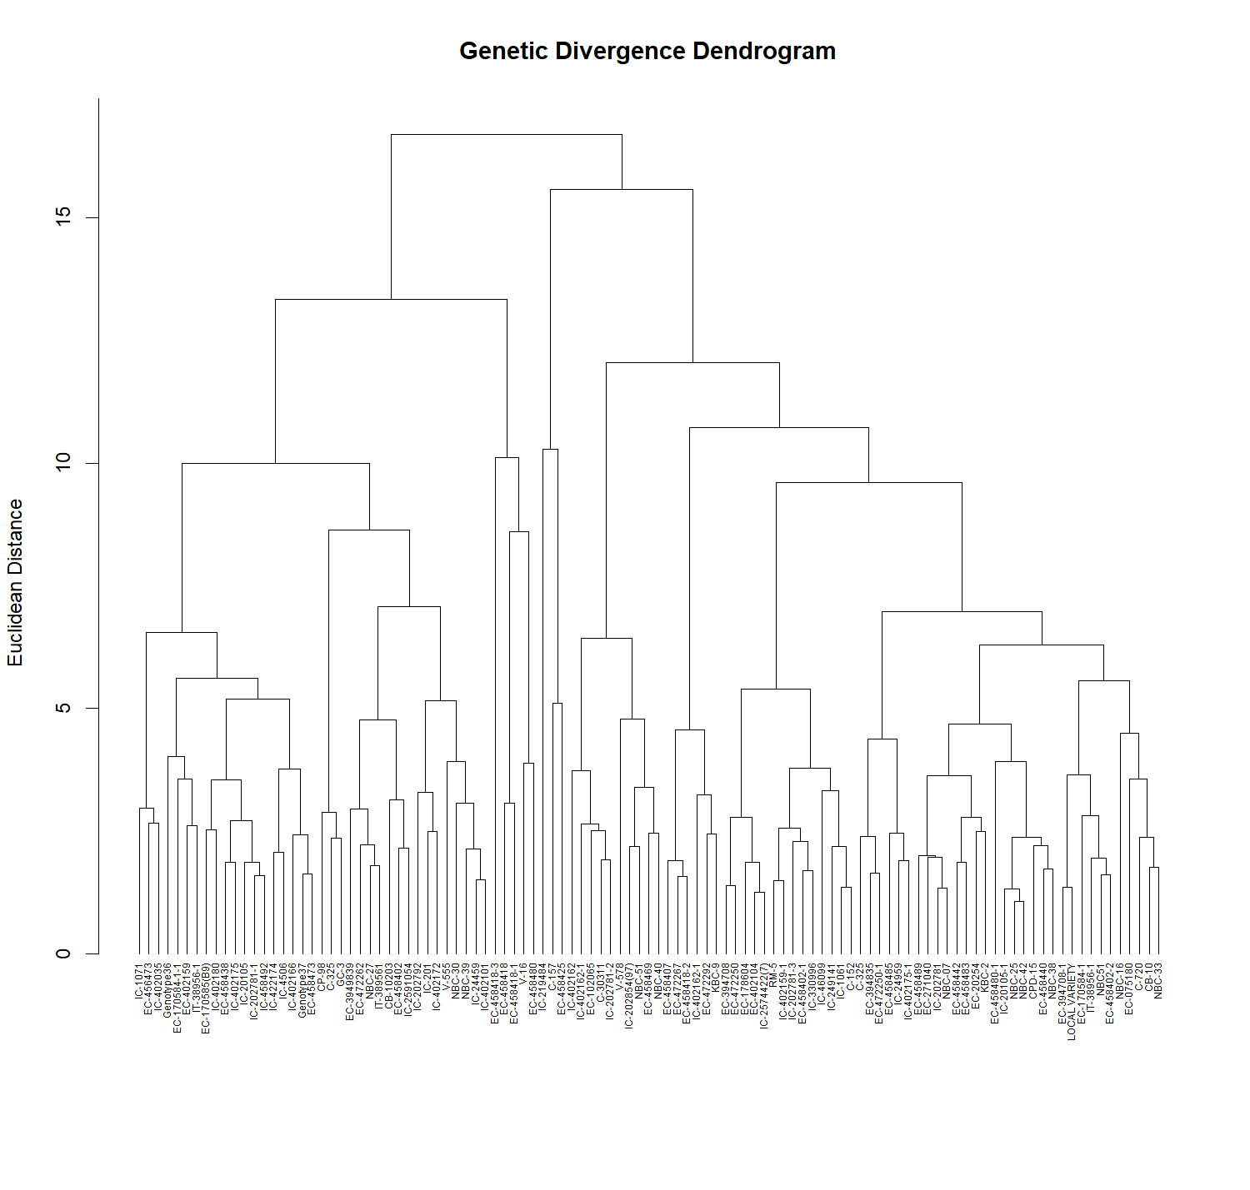
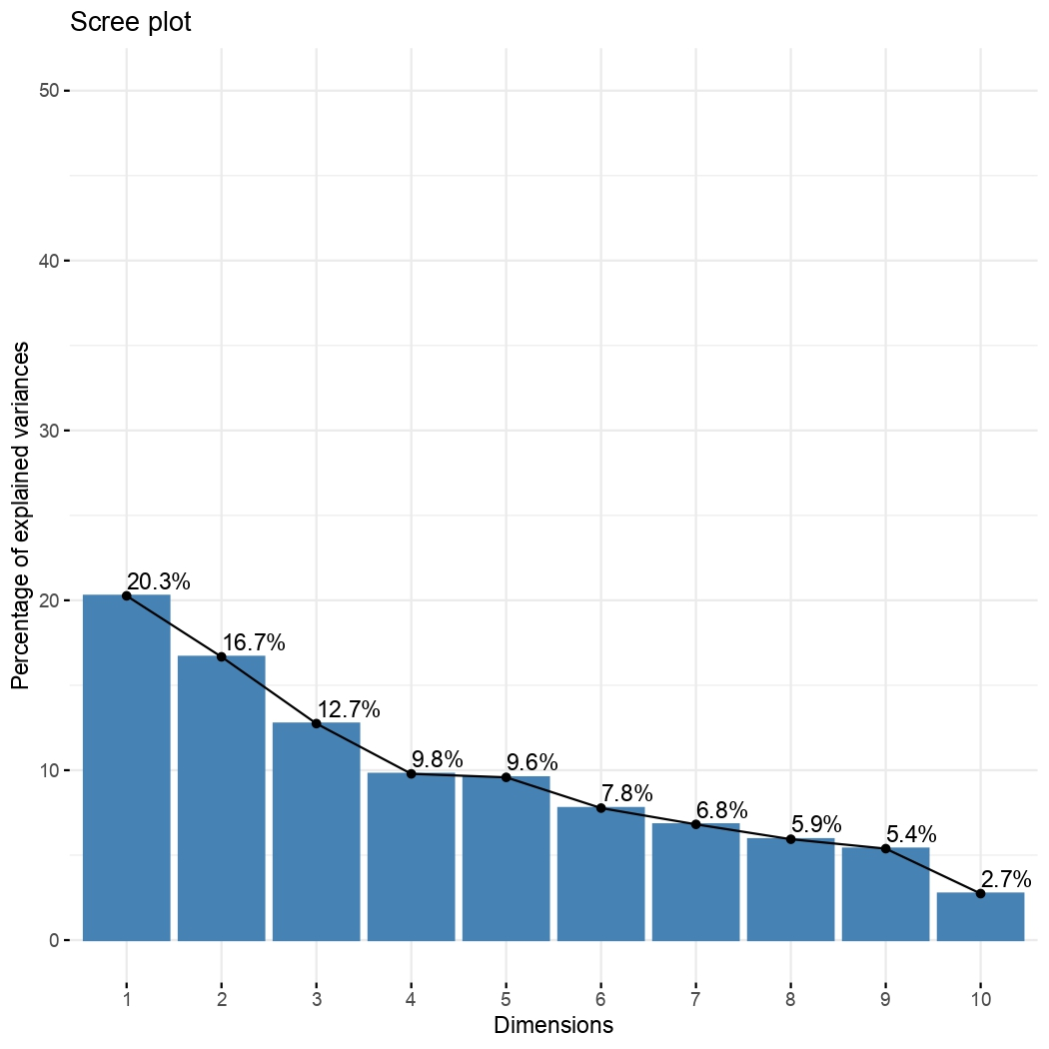
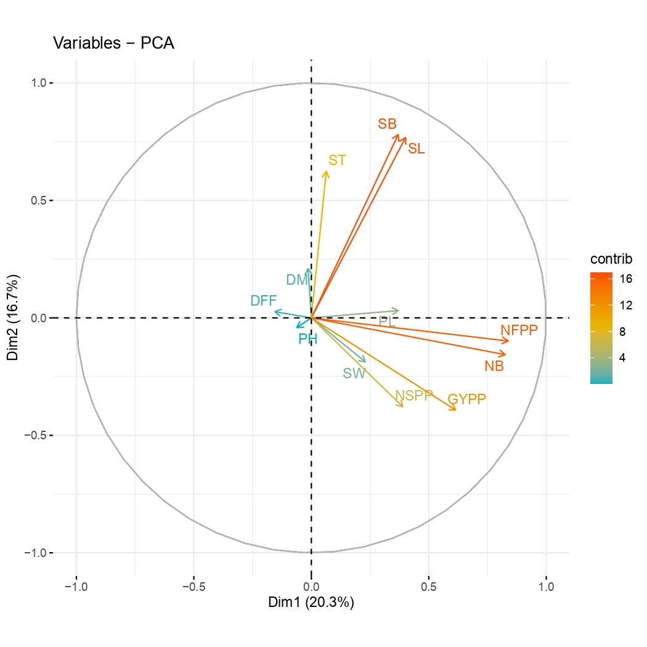
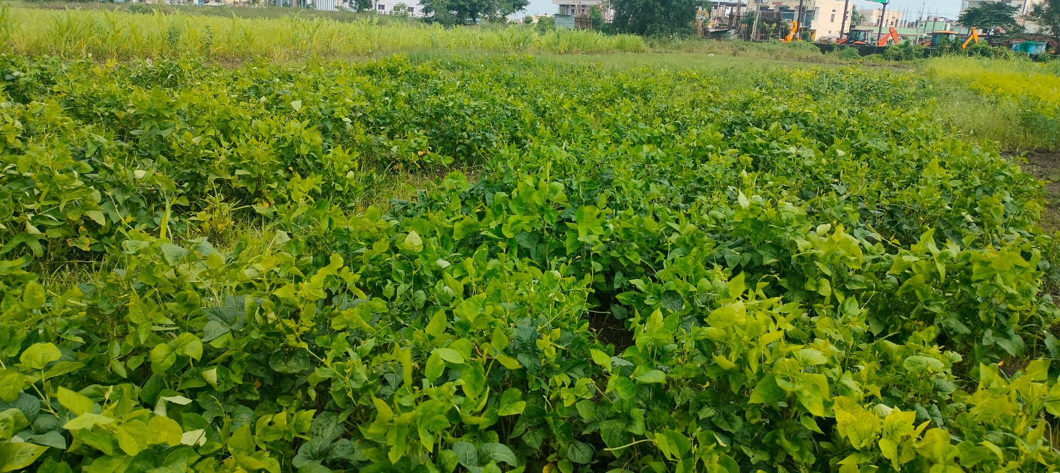
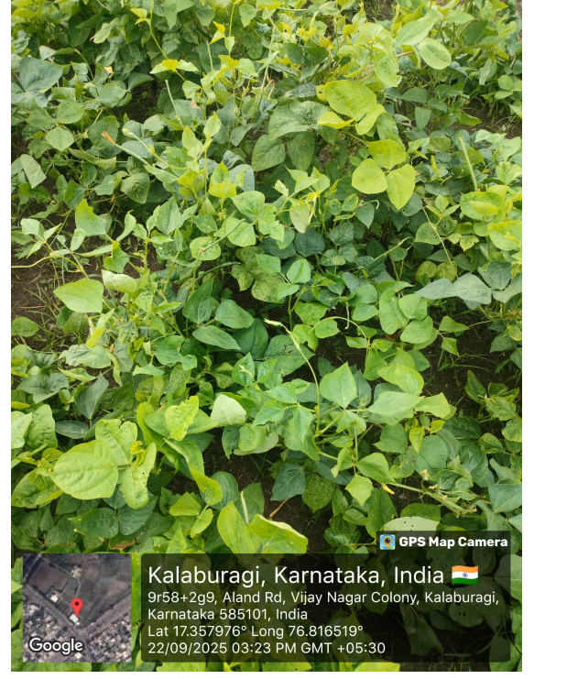
Study on Genetic Diversity and Principal Component Analysis for Grain Yield and Qunatitative Traits
in Cowpea (Vigna unguiculata L.)
* Pooja J.N., Hasan Khan, H.C.Sowmya, G.C.Shekhar and D.K.Vijay Kumar
Department of Genetics and Plant Breeding, College of Agriculture, Raichur
University of Agricultural Sciences, Raichur.
*Email I.D: poojajn16077@uasraichur.edu.in
INTRODUCTION
Table 1: Average inter and intra(bold) cluster values in cowpea genotypes based on seed yield and its attributing traits
Cowpea (Vigna unguiculata L. Walp.) is an important grain legume valued for its high protein content and adaptability to diverse environments.
Grain yield is a complex trait influenced by several quantitative characters. Genetic diversity is essential for identifying superior genotypes and developing improved varieties.
Principal Component Analysis (PCA) helps identify key traits contributing to genetic variation and supports effective selection in breeding programmes.
 | Cluster 1 | Cluster 2 | Cluster 3 | Cluster 4 | Cluster 5
Cluster 1 | 7.995 | 6.722 | 6.329 | 9.354 | 7.041
Cluster 2 |  | 3.693 | 2.209 | 7.014 | 3.282
Cluster 3 |  |  | 3.732 | 6.325 | 3.579
Cluster 4 |  |  |  | 4.652 | 7.216
Cluster 5 |  |  |  |  | 0.00
Fig. 1 Hierarchical Clustering of Cowpea Genotypes
OBJECTIVES
To study genetic diversity and principal component analysis in cowpea for grain yield and its attributing traits.
MATERIAL AND METHODS
The present investigation was conducted at College of Agriculture, Kalaburagi during kharif 2025. The experimental material consists of 107 cowpea genotypes with five checks viz., C-152, KBC-2, KBC-9, IT-38956-1 and a local variety and were laid out in an augmented design with six blocks.
These cowpea genotypes, including five standard checks, were evaluated for genetic diversity and principal component analysis (PCA) based on grain yield and its attributing traits.
Fig.2 Scree Plot Showing Percentage Variation Explained by Principal Components and PCA Biplot of Quantitative Traits
RESULTS AND DISCUSSION
Based on Mahalanobis D² analysis, the 107 cowpea genotypes were grouped into five clusters. The intra-cluster distance ranged from 0.00 to 7.995, with the highest value recorded in Cluster I (7.995), indicating greater variability within the cluster, this was in accordance with Chipeta et al.(2025).
The highest inter-cluster distance (9.354) was observed between Cluster I and Cluster IV, indicating maximum genetic divergence and suggesting these clusters as potential parents for hybridization.
Principal component analysis (PCA) identified five principal components with eigenvalues greater than 1.
PC1 explained the highest variation (20.26%), while PC1 to PC5 together accounted for 69.05% of the total genetic variation cowpea genotypes.
Traits such as number of pods per plant (NFPP), number of branches (NB), grain yield per plant (GYPP), number of seeds per pod (NSPP), seed breadth (SB) and seed length (SL) contributed most to the genetic variation.
Fig. 3 General view of experimental plot
CONCLUSION
Genetic diversity analysis revealed sufficient diversity among the evaluated cowpea genotypes for effective parent selection.
Genotypes from Clusters I and IV would serve as promising parents for hybridization to obtain superior transgressive segregants.
PCA successfully identified the key traits contributing to genetic divergence, facilitating efficient germplasm characterization.
REFERENCES
Mahalanobis, P. C., 1936, On the generalised distance in statistics. Proc. Indian Natl. Inst. Sci., 2: 49-55.
Chipeta, M. M., Kafwambira, J. and Yohane, E., 2025, Cowpea genetic diversity, population structure and genome-wide association studies in Malawi: Insights for breeding programs. Front. Pl. Sci., 15: 1461631.

